Slide 1
BIGTECHCOMPANY
Financial Overview

Slide 2
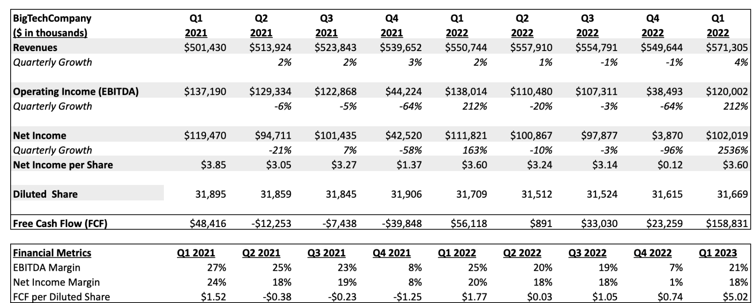
QUARTERLY PERFORMANCE
BigTechCompany

Slide 3
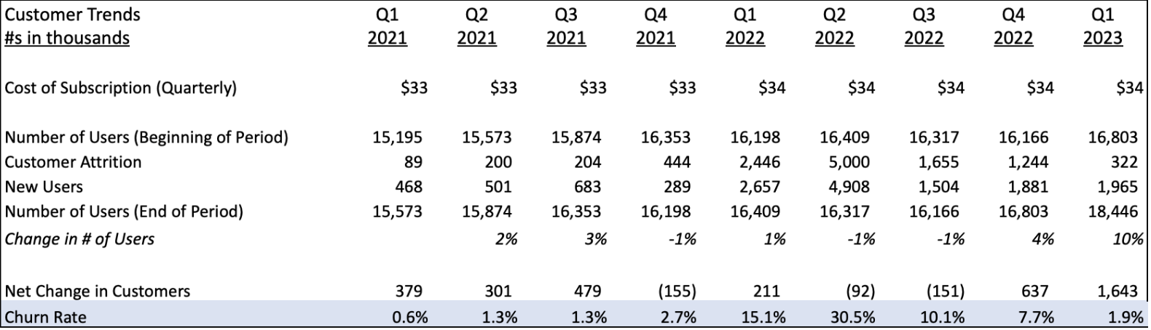
CUSTOMER TRENDS
BigTechCompany
Key Takeaways:
Sudden change in the price of subscription after Q4-2021 effect the customer which lead to increase in customer attrition but once it stable we can see decrease in customer attrition.
Increase in price directly increases the churn rate for a few quarter but churn rate settle down as the price stables.
Customer number are trending positive in a good pace.

Slide 4
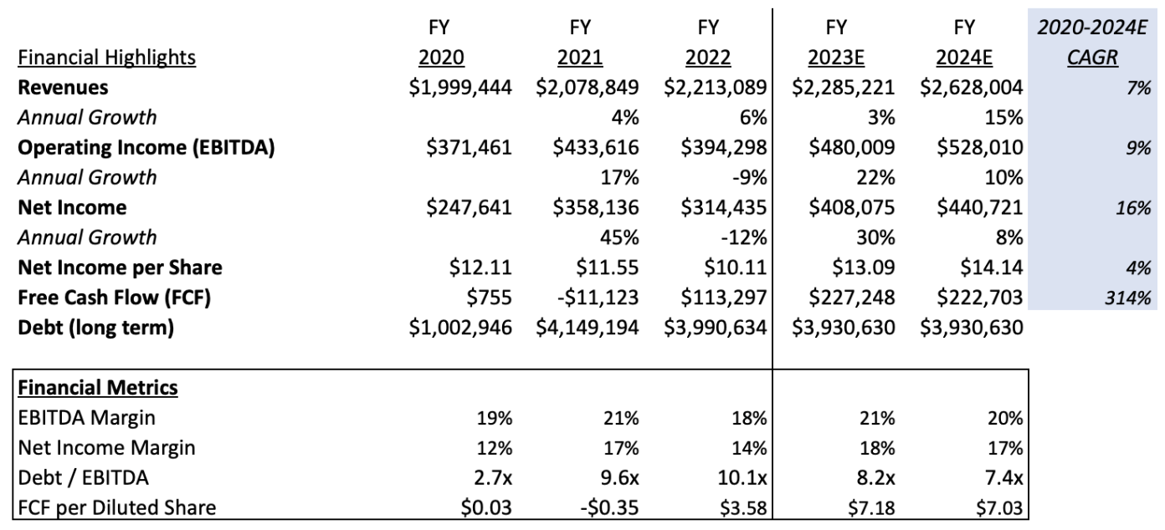
PROJECTIONS
BigTechCompany

Slide 5
CONCLUSIONS
BigTechCompany
Company Highlights
Growth in revenue is slow.
Company has worked on cash flow, it has brought down cash flow from negative to positive with a consistent growth.
Increase in debt led to increase in debt/EBITDA ratio, putting it far below from industry average.
Company’s net income is growing by a CAGR of 16%.
Areas of Concern
Net Income has high volatility on quarter bases.
In Q4 of 2022 there were some abnormal expenses noticed which effects EBITDA and Net profit
Company’s EBITDA margin is very low as compares to industry average.
Recommendation
Need to perform more than expected in 2023 and give a healthy year.
Company has high debt which is a sign of caution.
Need explanation on expenses incurred during Q4 of 2022

